Slide 1

Automated Lung Disease Detection from Chest X- Rays Using Transfer Learning
Supervised By: Dr. Shahzad Ahmed Qureshi
Dure Shahwar Fazal
Presented By: Muhammad Hamza Azhar
Sabir Hussain
Machine Learning Semester Project
Pakistan Institute of Engineering & Applied Sciences (PIEAS)

Slide 2
Presentation Outline
What is a Chest X-Ray?
Why Automate Chest X-Ray Interpretation?
What Diseases Are We Classifying?
About the NIH ChestX-ray14 Dataset
Challenges & Considerations
Class Imbalance

Slide 3
What is a Chest X-Ray?
A Chest X-Ray (CXR) is a medical imaging technique that uses low-dose X-radiation to visualize the internal structures of the chest including lungs, heart, and bones. It’s one of the most common radiological exams used to diagnose respiratory conditions.
Purpose:
Detect lung diseases
Identify bone abnormalities
Evaluate chest trauma

Slide 4
Why Automate Chest X-Ray Interpretation?
Clinical Need: Interpretation of chest X-rays is highly skilled - requiring radiologists to detect subtle signs of disease.
Machine Learning Use-Cases:
Classification of diseases
Localization of abnormalities
Computer-aided diagnosis (CAD)

Slide 5
What Diseases Are We Classifying?
There are 15 classes (14 diseases, and one for "No findings"). Images can be classified as "No findings" or one or more disease classes:
Atelectasis
Cardiomegaly
Consolidation
Edema
Effusion
Emphysema
Fibrosis
Hernia
Infiltration
Mass
Nodule
Pleural Thickening
Pneumonia
Pneumothorax

Slide 6
About the NIH ChestX-ray14 Dataset
Origin:
Released by the National Institutes of Health (NIH) Clinical Center (US).
One of the largest publicly available chest X-ray datasets
https://www.kaggle.com/datasets/nih-chest-xrays/data/data
Content:
112,120 frontal chest X-ray images
30,805 unique patients
Images may have multiple disease labels (multi-label classification).
Image Format:
Grayscale, frontal-view X-rays (PA or AP)
Stored normally at 1024×1024 pixels
Images also include patient metadata (age, gender, view).

Slide 7
Class Imbalance
Disease | Approximate Frequency
No Finding | ~50–60% of images
Infiltration | Common
Effusion | Moderate
Hernia | Rare
Many diseases occur much less frequently than normal images, which complicates training models.

Slide 8
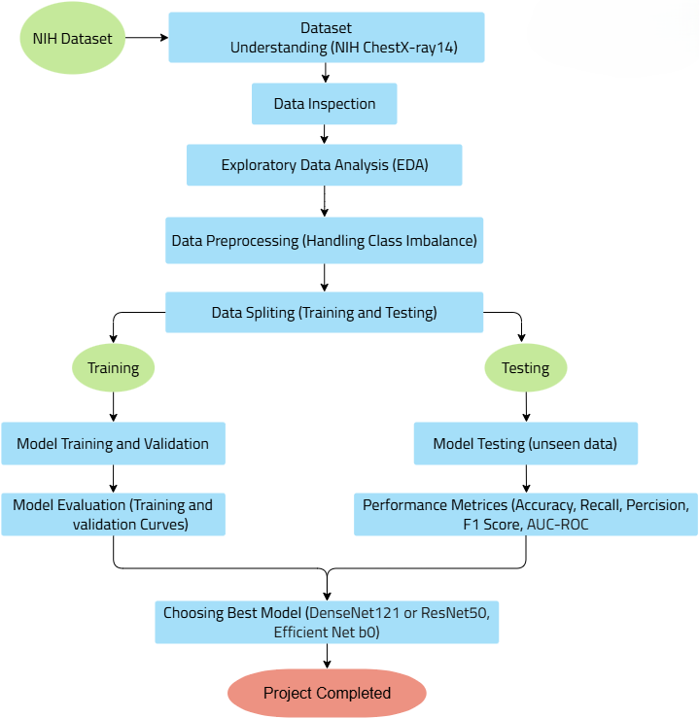
Flow Chart

Slide 9
Thank You
Any Questions?

